Slide 1
Ethical, Legal and Environmental Impact of Digital Technology
U01C09 | Mr Butler

Slide 2

What laws do we need to know?
The specification states we need to know about:
  Consumer Contracts Regulations Act 2013
  Data Protection Act 1998
  Copyright, Designs and Patents Act 1988
  Computer Misuse Act 1990

Slide 3

Consumer Contracts Regulations, 2013
Specifies the rights of customers when shopping online
Require online traders to provide customers with:
  A full description of the products available
  For digital download, compatibility (hardware/software requirements) must be given.
  Product prices
  Delivery charges
  Methods of payment accepted
  Information on how the products can be returned
A customer has the right to:
  cancel an order
  given a full refund for physical products (up to 14 days from received date)
    If digital download, may not be entitled to cancel
If the security seal is broken on a DVD/Blu-ray etc, they lose the right to cancel their order
  Also applies to digital goods that are tailor made by a company (i.e. wedding video)
Companies are not allowed to charge for items placed in electronic shopping baskets until the customer ‘checks out’ and agrees to purchase items

Slide 4


Data Protection Act, 1998
Legal Implications | Mr Butler

Slide 5
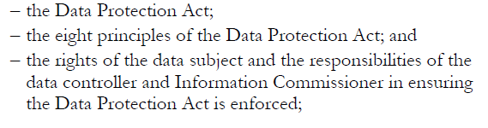
The Spec

Slide 6
Data Protection Act
Covers facts, figures and opinions about a person.
Provides a legal backup to protect Data Subjects from Data Users
Empowers individuals more control over how their information is used by individuals and organisations
The person of whom the data is about
Person who makes use of personal information for a certain purpose
i.e. secretary

Slide 7
The Key Roles
Person responsible for enforcing the Data Protection Act within the UK
Organizations need to apply to in order to gain permission to collect and store personal information
Data Commissioner
Usually in charge of the organisation
Decides what data needs to be collected and what it will be used for
Responsible for applying for permission to collect and store data in the first place.
Data Controller

Slide 8
Data Subject Rights
Has a right to be supplied by a data controller with the personal data held about him or her.
The data controller can charge for this (usually around £10 pounds).
Subject Access
A data subject may force the data controller to correct any mistakes in the data held about them
Right of Correction

Slide 9
Data Subject Rights
The data subject may prevent the use of information if it would be likely to cause them distress.
Prevent Distress
The data subject may stop their data being used in attempts to sell them things (i.e. via junk mail or cold calling).
Right to Prevent Direct Marketing

Slide 10
Data Subject Rights
A data subject may specify that they do not want a data user to make "automated" decisions about them
I.e. An individual applying for a personal loan online. The website uses algorithms and auto credit searching to provide an immediate yes/no decision on the application.
Prevent Automatic Decisions
A data subject can ask for the use of their personal data to be reviewed by the Information Commissioner who can enforce a ruling using the DPA.
The Commissioner may inspect a controller's computers to help in the investigation.
Complaint to the Information Commissioner

Slide 11
Data Subject Rights
The data subject is entitled to use the law to get compensation for damage caused ("damages") if personal data about them is inaccurate, lost, or disclosed.
  These rights only exist if you know who has data stored about you
  Some data controllers are exempt from the Act
Right to Compensation

Slide 12
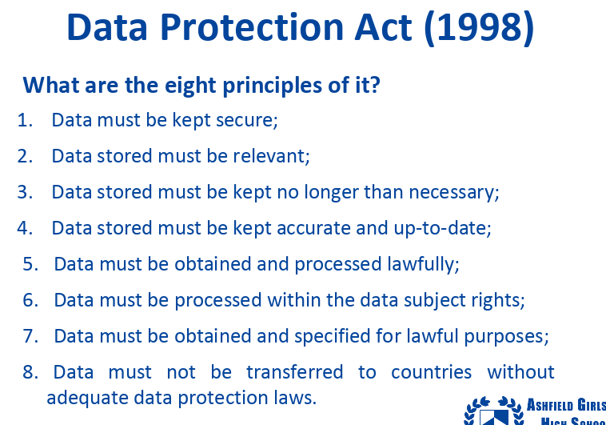
The 8 Principles

Slide 13

Copyright Designs and Patents Act, 1988
Legal Implications | Mr Butler

Slide 14

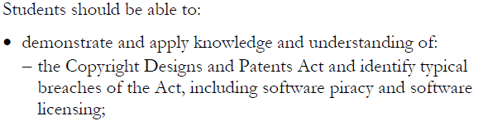
The Specification

Slide 15
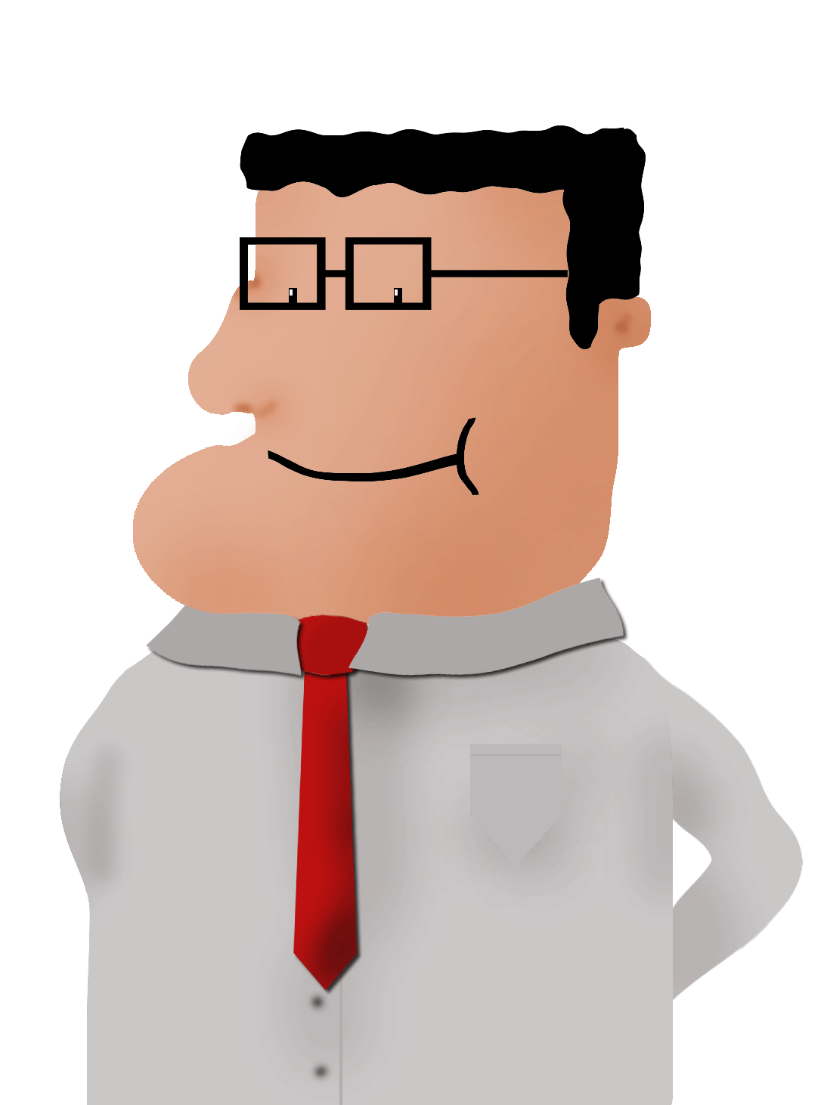
Explain the principles behind the Copyright, Designs and Patents Act
List the implications of breaking the act
Distinguish between the 3 types of software licence
State 2 methods of protecting against software piracy
Define the term plagiarism

Slide 16
To breach or not to breach?
Jane wants to use an image she found on the internet for her ICT coursework. She contacts the owner to check if she can use it. The owner gives Jane their permission. Has Jane breached the act? Why? Why not?
  No, she has not breached the act. She gained the owners permission from the owner before using the material.
Sam purchases a song from iTunes to use in his Moving Image coursework. His friend, Tom, asks for a copy of the song for his project. Is this a breach of the Act?
  Yes, both Sam and Tom have breached the Act. Although Sam legally purchased the music, he breached the act by sharing the music file. Tom also breached the act as he has used the song without a licence.

Slide 17
What is the Act for?
This act was designed to address:
Illegally copying/distributing/downloading software
Theft of ideas from one company for use in another
Using software with an unlicensed key
Downloading software/images without payment

Slide 18
How do you break the Act?
Download and use copyrighted images
Install software without licence / bypassing the licence
Illegal file-sharing
Copy/pasting from a website/ebook/etc and declaring it as your own

Slide 19

Copying Images from the WWW
Images and photos on the WWW are protected the exact same as printed/published work
  I.e. Soft copies are still protected by copyright law
Images can be downloaded legally under the following circumstances:
  The image is open source / Non-copyright
  Credit is given to the creator
  Pay the publisher to use the material
  Do not use the image for profit/commercial use
Allows people to publish images/etc for public to use conditionally free of charge

Slide 20
Using Software
Software can only be installed on a PC/network if the correct licence is obtained
Network admins must be careful to get the correct licence when installing on a network
Three categories:
  Single: Only one instance of software / single PC
  Multi-user: Specified number of instances of software/PCs
  Site: All PCs connected on the network can be installed at any site

Slide 21
Protecting against Software Misuse
Federation
Against
Software - Organisation to police software licencing
Theft - Prosecutes those breaching licence
Online Registration - must authenticate online before use
CD/DVD Use - CD must be in tray to use

Slide 22
File Sharing
Unless you specifically own the copyright, file sharing is illegal
iTunes, for example, has a licence – so you can legally download music/films
  You can ‘rip’ CDs (make a copy) to backup the original disk – but you cannot distribute it
  You cannot give a copy in any format to anyone else (unless it is the licensee).

Slide 23

Plagiarism
Glossary
Item Added
Using others work without credit and claiming it as your own
Increasing problem in schools
Sophisticated software is used to detect cases of plagiarism

Slide 24

The Computer Misuse Act, 1990

Slide 25
WALTer
By the end of this lesson, you should be able to:
Describe and explain the purpose of the Computer Misuse Act
List the 4 main offences set out in the act.
Define 2 preventive measures companies and individuals can take
Define the terms ‘hacking’, ‘virus’, ‘spyware’ and ‘phishing’.

Slide 26
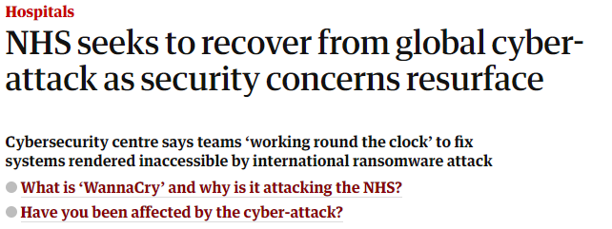


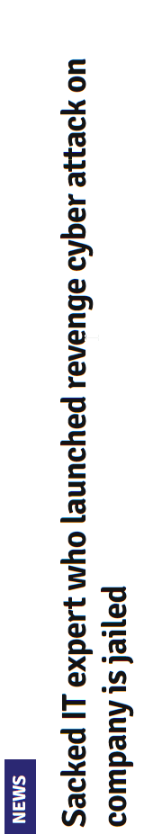

Computer Misuse in the News
The misuse of computers appears in the news quite regularly nowadays
The NHS, TalkTalk and (possibly) the Whitehouse Emails by the Russians

Slide 27


The Computer Misuse: The 4 Main Offences
Unauthorised access to computer material
This is the lowest level of the offence.
Example: A business owner hacking into a competitors network
Jail: Up to 2 years
Fine: £5000

Slide 28


The Computer Misuse: The 4 Main Offences
Unauthorised access to computer materials with intent to commit a further crime
Examples include planting a virus or stealing a password to bank account
So this business owner has hacked into a competitors network in order to plant a virus
Jail: Up to 5 Years
Fine: Unlimited

Slide 29

The Computer Misuse: The 4 Main Offences
Unauthorised Modification of Data
Changing or deleting data, including the use of spyware
Example: A business owner hacking into a network to change data
Jail: Up to 10 Years
Fine: Unlimited

Slide 30

The Computer Misuse: The 4 Main Offences
Making, supplying or obtaining anything which could be used in computer misuse offences
Creating virus’ or spyware, selling spyware or purchasing spyware
Jail: Up to 10 Years
Fine: Unlimited

Slide 31
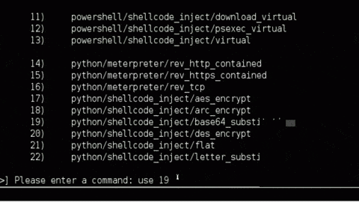
Hacking
Glossary
Item Added
The act of intentionally accessing a computer system without consent
‘Hackers’ attempt to take control of a system by viewing, accessing or running programs from another persons computer without their permission

Slide 32

Virus
A program that has been designed to damage the operation of a computer automatically
They can corrupt, erase or alter files and can slow down/crash computers

Slide 33
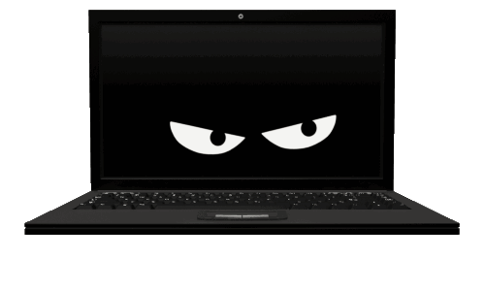
Spyware
Malicious software which is secretly installed on a users computer
Uses an internet connection to send information back to hacker about the users activity

Slide 34
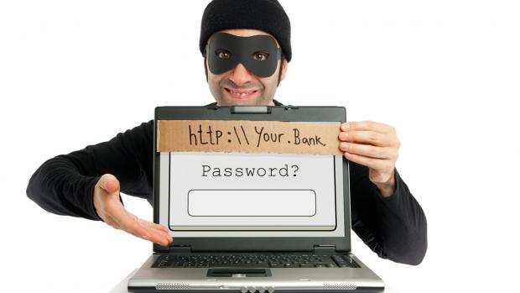
Phishing
Sending emails that appear to be from a reliable source
These often ask to update their personal information by clicking on a hyperlink to a bogus website
Used in identity theft
Attempting to gain personal information about someone by deceiving them.

Slide 35
Preventing Computer Misuse
We can protect ourselves against hackers by:
Complete Regular backups
Use Antivirus software
Use Strong passwords
Be vigilant with suspicious/spam emails

Slide 36
Issues with Prosecuting
Very few cases are filed under the computer misuse act due to:
Hard to trace perpetrator
Hard to collect evidence
Seen as ‘soft crime’
Difficult to prove intent

Slide 37
Reminder: Key Terms
Glossary
Items Added
Hacker
  A person/group involved in cyber crime. i.e. who access a computer system without permission in order to do damage
Virus
  A piece of software designed to disrupt the normal operation of a computer
Spyware
  Software that can steal data/information from a computer system
Piracy
  Illegally downloading information/data which you do not have permission to have

Slide 38
Health and Safety when working with ICT

Slide 39
WALTer
Identify the Health and Safety issues related to Digital Technology
Apply your knowledge to suggest why these issues arise
Offer a possible solution to eradicate or reduce these problems

Slide 40
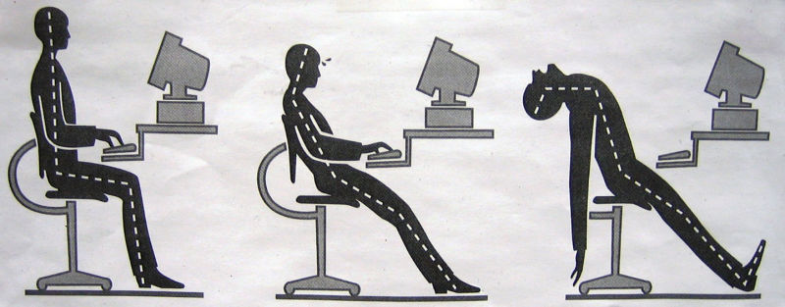
Poor Ergonomics
The science concerned with designing safe and comfortable hardware and office furniture for humans
What is wrong with this posture?
TASK: Complete the Health and Safety Worksheet by suggesting what is wrong with the environment / ergonomics

Slide 41

A danger or risk which is any source of potential damage, harm or adverse health effects on something or someone.
Definition: Hazard

Slide 42
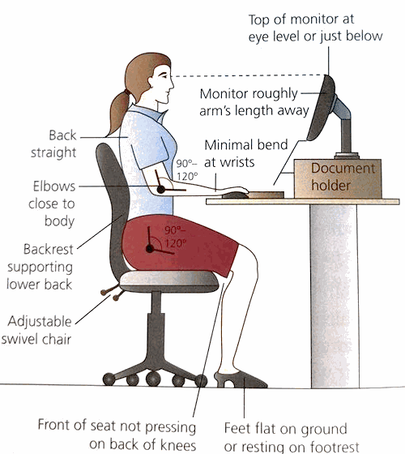
THE IDEAL SETUP

Slide 43
Repetitive Strain Injury
Repetitive Strain Injury (RSI) is a range of conditions, and can affect:
      The Neck
      Shoulders
      Arms
      Hands/Fingers
What Causes RSI?
      Repetitive actions, such as working on a keyboard all day
      Using controller for extended periods
      Can result in Carpal Tunnel Syndrome (A condition in the wrists)
Reduction of RSI
      Taking regular breaks
      Using ergonomically designed products (such as keyboards, mouse and foot stools)
      Use appropriate furniture (such as adjustable swivel chair)
      Use an arm rest to avoid carpel tunnel

Slide 44
Back Pain
This is a common problem which has been related to poor posture
      Sitting at a PC all day without breaks, and with incorrect seating position
Possibly lead to mobility problems
Reduction of Back Problems
        Use an adjustable chair (tilting, adjustable height) – one that supports your back
        Taking regular breaks
        Regularly exercising (walking/etc during break)
        Ensure posture is correct when seated

Slide 45
Eye Strain
This is a common problem caused by over-exposure to computer/digital screens
Can cause headaches, blurred vision, and bad eyesight
Reduction of Eye Strain
        Using anti glare screens
        Use an adjustable screen (swivel/etc) that can be adjusted to reduce glare
        Adjust brightness/contrast on the monitor
        Good natural light / brightly lit room
        Have regular eye tests

Slide 46
ELF Radiation
Older monitors emit very low levels of extremely low frequency radiation
LCD screens emit virtually no radiation
Solutions:
Best to sit at least 2 feet from the monitor.
Cover the screen with an anti-radiation protector
Restrict time in front of monitor.

Slide 47
WALTer
Identify the Health and Safety issues related to Digital Technology
Apply your knowledge to suggest why these issues arise
Offer a possible solution to eradicate or reduce these problems

Slide 48
Health and Safety in the Workplace
Teleworking | Employers Obligations

Slide 49
WALTer
List 5 hazards related to ICT that should be addressed by an employer.
Surmise how employers can address these issues in the workplace
Explain the Term “Teleworking”
Give three examples of health problems associated with teleworking
Describe the causes, symptoms and prevention of Deep Vein Thrombosis

Slide 50
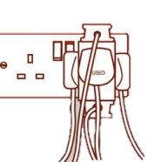
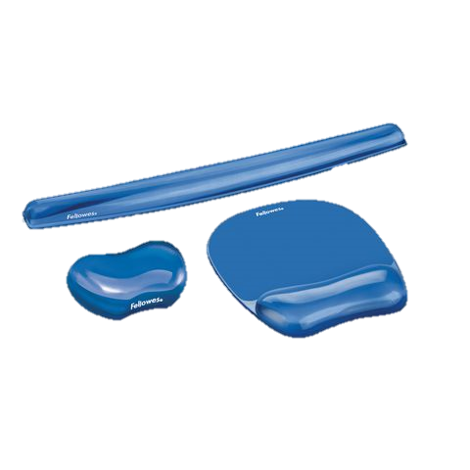
Risks in the ICT Room
Overloaded Sockets
Wires on / across the floor
Food and Drinks near the computers
Heating / ventilation requirements (not blocking fans etc)
Suitable desks and equipment
Adequate space around the machine
Frequent Breaks
Foot / hand supports
Heating/ Air conditioning Units

Slide 51

Health and Safety: Employers Responsibilities
Covered in the Health and Safety at Work etc. Act 1974
By Law, an employer is required to ensure/ provide:
  Staff have access to tiltable Screens
  anti-glare screen filters
  Provide adjustable chairs
  Provide foot supports
  Ensure workstations are not cramped
  Plan work at a computer so that there are suitable/frequent breaks
  Pay/provide appropriate eye tests by an optician
  These regulations do not apply to students in schools/ colleges

Slide 52
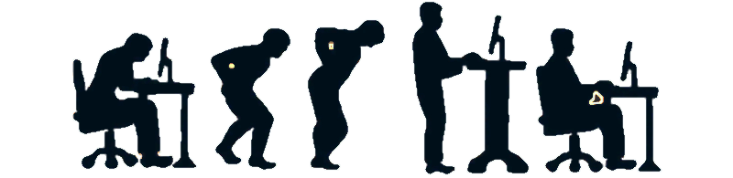
Ergonomics
A way to ensure these regulations are met is by using ergonomics.
This is the science concerned with designing safe and comfortable working environments for humans.
  This includes furniture design, as well as equipment such as keyboard and mouse.

Slide 53
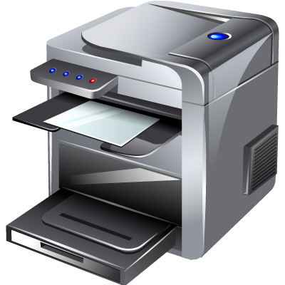

Q. Do Laser Printers have an impact on our health?
Answer: Yes, they can. They are suggested that ozone emitted from these printers can lead to breathing problems.
A possible solution for this would be to ensure printers are situated away from where people are sitting, and have good ventilation in the immediate area.

Slide 54
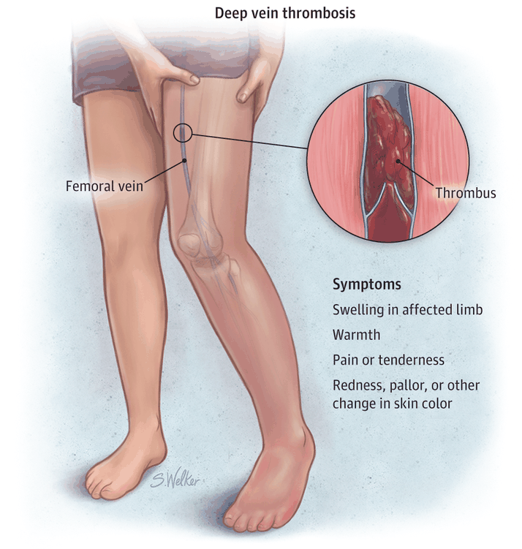
Deep Vein Thrombosis (DVT)
DVT is a condition in which a clot is formed in a leg vein.
Requires hospital treatment, and can be life threatening.
Caused by sitting for long periods of time
Prevention
  Take regular breaks
  Use an adjustable chair, with feet flat on ground
  Sit with a suitable posture – do not cross your legs for long periods

Slide 55
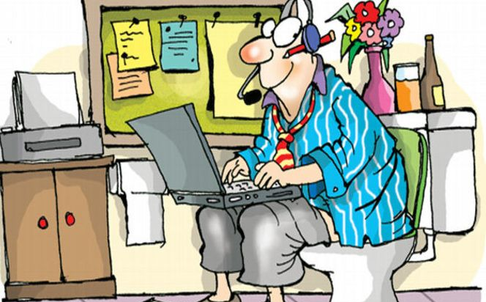
Teleworking
Using technology and telecommunications to work
from home, which replaces work related travel.
Saves on travel costs.
Uses tablets and other mobile devices to access the internet/etc and video conferencing.
Reduces boundaries between work and home, often making the boundary indistinct.
Companies can offer 24/7 services.
This means staff can often work day shifts/night shifts.

Slide 56

Health Problems associated with Teleworking
If work is taken home, employees can find that their stress levels are increased as there is ‘no escape’ from work life.
Lack of support/inadequate equipment
Social Isolation
Can work longer hours than paid/ required (aka presenteeism)
Increased stress levels / feeling of overburdening

Slide 57
WALTer
List 5 hazards related to ICT that should be addressed by an employer.
Surmise how employers can address these issues in the workplace
Explain the Term “Teleworking”
Give three examples of health problems associated with teleworking
Describe the causes, symptoms and prevention of Deep Vein Thrombosis

Slide 58

Checkpoint
Health problems associated with the regular use of computers include RSI, back strain and eye strain.
By using ergonomically designed furniture, we can help to reduce these risks.
Employers have an obligation to provide a safe working environment for employers, whether or not the work is conducted at home (teleworking), or in the office.
The Health and Safety at Work etc. Act 1974 states this responsibility.

Slide 59

Internet Misuse
ETHICAL ISSUES
PLAGAIRISM
HACKERS
Think about the following situations and think about whether it is right or wrong:
  Copying work from a website and using it as your own
  Copying a CD you have bought for a friend
  Spreading malicious rumours about someone online
  Using someone else’s password
  Taking and distributing a picture of someone with the purpose of embarrassing them
Ethical Issues: Your sense of what is right and what is wrong.
Plagiarism: The internet is an excellent source of information on almost anything you want to find out about. The problem is that it is all too easy for someone to copy work from the internet and use it as their own. Educators also have a big issue with plagiarism in schools and universities as students can easily copy work from the internet and try to pass it off as their own.
Hackers can misuse the internet to gain unauthorised access to personal and/or private data. Another problem with internet misuse is the spread of viruses. Viruses don’t happen accidentally.
describe the ethical impact of technology on society, referring to the following:
  internet misuse;
  access to personal information;
  social media misuse;
  the implications of global positioning system (GPS) and tracking;
  concerns about the security of personal data.

Slide 60
Access to Personal Information
PHISHING
IDENTITY THEFT
Identity Theft: This has become an alarmingly increasing problem in society today.
People tend to post a lot of personal information about themselves on various different social media platforms.
This makes it very easy for someone else to effectively steal their information in order to use them to create a bank account, get a credit card etc.
describe the ethical impact of technology on society, referring to the following:
  internet misuse;
  access to personal information;
  social media misuse;
  the implications of global positioning system (GPS) and tracking;
  concerns about the security of personal data.

Slide 61
Social Media Misuse
CYBERBULLYING
Cyberbullying is a huge problem with young people using social media. Bullies can post nasty comments or messages about their victim.
Even worse is that they can hide behind a fake profile (Catfish) or even post anonymously on some platforms (Yik Yak).
There is also a privacy issue when social media users give away too much personal information about themselves such their address, date of birth etc and leave it accessible to everyone
describe the ethical impact of technology on society, referring to the following:
  internet misuse;
  access to personal information;
  social media misuse;
  the implications of global positioning system (GPS) and tracking;
  concerns about the security of personal data.

Slide 62
GPS and Tracking
GLOBAL POSITIONING SYSTEM
TRIANGULATION
GPS stands for Global Positioning System.
It was invented by the US military to allow soldiers to know where exactly they were in the world.
GPS uses a process called ‘Triangulation’ to work out the location using triangluation.
  Satellites are used to help pinpoint the location.
  It works best outdoors but does give an accurate location.
  It may not be accurate if the preinstalled map on the device is not up to date.
How does GPS work?
Satellites transmit signals to earth, where the GPS device receives the signals
The device calculates its location based on the information from at least 3 satellites (Triangulation)
Then the location is shown on a map that is preinstalled in the GPS device to within a couple of metres.
GPS is also used to help ships navigate the sea, to ‘tag’ criminals so the police can monitor their whereabouts and even for recreational purposes by the likes of hikers and mountaineers to identify their location.
describe the ethical impact of technology on society, referring to the following:
  internet misuse;
  access to personal information;
  social media misuse;
  the implications of global positioning system (GPS) and tracking;
  concerns about the security of personal data.

Slide 63
Security of Personal Data
DATA PROTECTION ACT
PRIVACY SETTINGS
We all willingly give up our personal data on a daily basis on the internet.
This is done every time you fill in an online form, register your details on a website etc.
Through social media sites such Facebook and online collaboration sites such as Google, we are putting our own personal data at risk. Concerns have been raised about how this data is being used.
It is up to the user to check their privacy settings to try to control the privacy of their data effectively. Often these privacy settings can be confusing and therefore make it difficult for the user to know what to choose.
Any example of this is that by default, a Facebook user profile will automatically be public when the user turns 18. The sharing of our personal data with third party websites and applications is also a huge concern.
This data could be used for data mining which is when organisations turn raw data into useful information. Mobile technology users are exposed to continuous streams of adverts online based on previous online searches.
describe the ethical impact of technology on society, referring to the following:
  internet misuse;
  access to personal information;
  social media misuse;
  the implications of global positioning system (GPS) and tracking;
  concerns about the security of personal data.

Slide 64


Describe the impact of digital technology on employment including
  Job opportunities
  Job displacement
  Changes in work patterns
  Need for upskilling
In the 1930’s a computer was a job
  What did it do
    The same thing it does now. Calculates large or difficult maths problems for companies or research groups
Jobs continually change depending on changes in the technology of the time
Computers have made a massive difference in the way we work and which jobs we do

Slide 65
Describe the impact of digital technology on employment including
  Job opportunities
  Job displacement
  Changes in work patterns
  Need for upskilling
While computers are reducing the need for jobs in other sectors there is a continual increase in computing related jobs
  Programmers
  Software Engineers
  ICT Technicians
  Network Managers
  ICT Consultants
  App Developers
  Web Designers
  Social Media Manager

Slide 66
Describe the impact of digital technology on employment including
  Job opportunities
  Job displacement
  Changes in work patterns
  Need for upskilling
This is down to a number of factors;
  New jobs being created due to technology that previously didn’t exist
  More and more demand for computing within work places
    Jobs in installation
    Jobs in maintaining
    Jobs in production
  More jobs being automated or streamlined due to computing so higher demand for those skills

Slide 67
Describe the impact of digital technology on employment including
  Job opportunities
  Job displacement
  Changes in work patterns
  Need for upskilling
Currently there are more jobs being created in computing than there are people to fill them
Have some extremely good pay schemes
Huge ability to travel and work in more enjoyable environments and ways

Slide 68
Describe the impact of digital technology on employment including
  Job opportunities
  Job displacement
  Changes in work patterns
  Need for upskilling
Job displacement
  A computer was one job that has vanished
  Can we think of anymore that are on the decline or disappeared
    Typist
    Secretary
    Factory workers
    Bankers
    Post sorters
    Manufacturing of clothes (or anything)
    Street shops

Slide 69
Describe the impact of digital technology on employment including
  Job opportunities
  Job displacement
  Changes in work patterns
  Need for upskilling
Work patterns
  Traditional
    Working 9 to 5
    Based in an office block
    Generally assign asks to do solo
  Current changes
    Offices still exist but the layout and style has changed
    Can work any hour you wish in some cases providing you still work the required amount of time
      Helpful for families
    Can work anywhere with teleworking
  Find pictures showing the two examples

Slide 70
Describe the impact of digital technology on employment including
  Job opportunities
  Job displacement
  Changes in work patterns
  Need for upskilling
Teleworking
  The ability to work from home using computers, mobile devices and internet connections
  Through email and video conferencing an employee is never out of touch
  However there are advantages and disadvantages to the employee and employer

Slide 71
Describe the impact of digital technology on employment including
  Job opportunities
  Job displacement
  Changes in work patterns
  Need for upskilling
Advantages | Disadvantages
Costs – saves travel costs and time for employer and employee - cheaper on electricity, heating and office space for employer | Discipline – employees need to remain focused themselves by either having their own office or working the required amount of time
Location – ability to hire people from any location in the world providing a wider range of suitable employees | Social – employees can feel isolated because there is less team working and social interaction
Flexibility – flexible working hours which allows more people to work around other commitments | Monitoring – it is harder for managers to check how everything is going and employees can find it hard to contact someone in an emergency
Society – fewer cars on the road means less pollution and congestion - Wealth is no longer centred on cities
Equal opportunities – people with disabilities that might limit their movement can work in a comfortable environment for them

Slide 72
Describe the impact of digital technology on employment including
  Job opportunities
  Job displacement
  Changes in work patterns
  Need for upskilling
Upskilling
  Technology keeps moving
    We need to keep our skills inline with current technology
  Companies need to keep training their employees to keep their skills relevant to the latest hardware or software

